Slide 1

School of CSE
Course Delivery
B.Tech (CSE) - II Semester
By
Dr. N P Nethravathi
Professor
nethravathi.np@reva.edu.in

Slide 2
UNIT -4
Structures & Union: Derived types- structures- declaration, definition and initialization of structures, accessing structures, nested structures, arrays of structures,
union, typedef.
File Operations: Formatted Input & Output, Character Input and Output Functions, Direct Input and Output Functions, File Positioning Functions, Error Functions

Slide 3

Unions
Unions are similar to the structures in C.
Union is also a derived type as structure.
Union can be defined in same manner as structures.

Slide 4
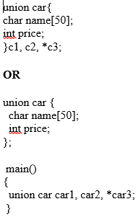
Unions
Union variables can be created in similar manner as structure variable.
In both cases, union variables car1, car2 and union pointer variable car3 of type union car is created.

Slide 5
Unions
Accessing members of an union
The member of unions can be accessed in similar manner as that structure.
Suppose, we you want to access price for union variable c1 in above example, it can be accessed as c1.price.
If you want to access price for union pointer variable c3, it can be accessed as (*c3).price or as c3->price.

Slide 6
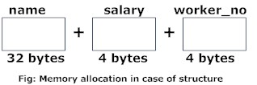
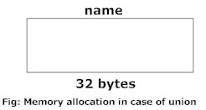
Unions
Difference between union and structure
  1. More memory is allocated to structures than union
The amount of memory required to store a structure variable is the sum of memory size of all members.
But, the memory required to store a union variable is the memory required for the largest element of an union.

Slide 7
Unions
  2. Only one union member can be accessed at a time
All members of structure can be accessed at any time.
But, only one member of union can be accessed at a time in case of union and other members will contain garbage value.

Slide 8
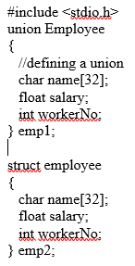
Unions
Write a C program using union to display the total memory size occupied by the data types.

Slide 9
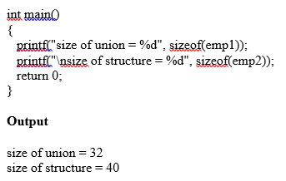
Unions
Write a C program using union to display the total memory size occupied by the data types.

Slide 10
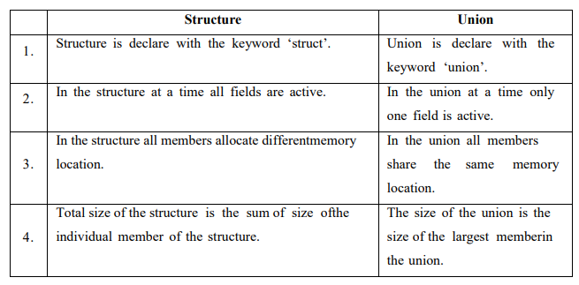
Unions
Difference between Structure and Union

Slide 11
Files
A file represents a sequence of bytes on the disk where a group of related data is stored.
File is created for permanent storage of data. It is a readymade structure.
In C language, we use a structure pointer of file type to declare a file.
FILE *file_pointer_name; Ex: FILE *fp;
To use a file four essential actions should be carried out. These are,
Declare a file pointer variable.
b. Open a file using the fopen() function.
c. Process the file using suitable functions.
d. Close the file using the fclose() functions

Slide 12
Files
Different operations that can be performed on a file are:
Function description
fopen() create a new file or open a existing file
fclose() closes a file
fgetc() reads a character from a file
fputc() writes a character to a file
fgets() reads string from a file
fputs() writes a string to a file
fscanf() reads a set of data from a file
fprintf() writes a set of data to a file
fseek() set the position to desire point
ftell() gives current position in the file
rewind() set the position to the beginning point

Slide 13
Files
Opening a File or Creating a File
*fp= FILE *fopen (const char *filename, const char *mode)
fopen() function is used to open a file to perform operations such as reading, writing etc.
filename is the name of the file to be opened and
mode specifies the purpose of opening the file. Mode can be of following types,
mode description
r: opens a text file in reading mode
w : opens or create a text file in writing mode.
a : opens a text file in append mode
r+ : opens a text file in both reading and writing mode (updating)
w+ : opens a text file in both reading and writing mode (overwrite or create)
a+: opens a text file in both Append and read mode
*fp is the FILE pointer (FILE *fp), which will hold the reference to the opened (or created) file.

Slide 14
Files
Opening a File or Creating a File
1) *fp= FILE *fopen (const char *filename, const char *mode)
fopen() function is used to open a file to perform operations such as reading, writing etc.
filename is the name of the file to be opened and
mode specifies the purpose of opening the file. Mode can be of following types,
mode description
r: opens a text file in reading mode
w :opens or create a text file in writing mode.
a :opens a text file in append mode
r+ :opens a text file in both reading and writing mode
w+ :opens a text file in both reading and writing mode
a+: opens a text file in both reading and writing mode
*fp is the FILE pointer (FILE *fp), which will hold the reference to the opened (or created) file.

Slide 15
Files
Closing a File : 2) int fclose( FILE *fp );
fclose() function closes the file and returns zero on success, or EOF if there is an error in closing the file. EOF is a constant defined in the header file stdio.h. Ex: fclose (fp);
Character input / output:
3) int fgetc( FILE * fp );
The fgetc() function reads a character from the input file referenced by fp. in case of any error, it returns EOF. Ex: fgetc(fp);
4) int fputc( int c, FILE *fp );
The function fputc() writes the character value of the argument c to the output stream referenced by fp. Ex: fputc(ch, fp);

Slide 16
Files
String input / output:
5) int fputs (const char *string, FILE *fp)
fputs function writes string into a file pointed by fp. It returns a non-negative value on success, otherwise EOF is returned in case of any error.
Ex: fputs (“some data”, fp);
6) char fgets( char string, int n, FILE *fp );
fgets() reads characters from the input stream referenced by fp.
It copies the read string into the buffer buf, appending a null character to terminate the string.
Ex: fgets(str,80, fp);

Slide 17
Files
Reading and Writing from File using fprintf() and fscanf()
7) fprintf(FILE *fp, ”type specifier” , var-list);
write a string into a file.
Ex: fprintf(fp, "This is testing for fprintf...\n");
8) fscanf(FILE *fp, ”type specifier” , var-list);
function to read strings from a file, but it stops reading after
encountering the first space character.
Ex: fscanf(fp, "%s", buff);

Slide 18
Files
File Positioning Functions / Random Access to files of records
9) rewind() function is used to move file pointer position to the beginning of the file.
void rewind(FILE *fp) Ex: rewind(fp);
10) fseek() function is used to move file pointer position to the given location. int fseek(FILE *fp, long int offset, int pos)
fp – file pointer
offset – Number of bytes/characters to be offset/moved from position/the current file pointer position.
pos – this sets the pointer position in the file.
11) ftell() function is used to get current position of the file pointer. The value is count from the beginning of the file.
long int ftell(FILE *fp) Ex: ftell(fp);

Slide 19
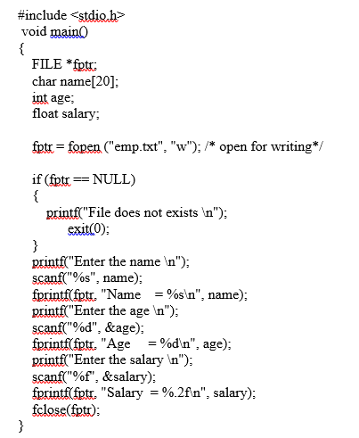
Files
C program to create a file called emp.txt and store information about a person, in terms of his name, age and salary. */

Slide 20
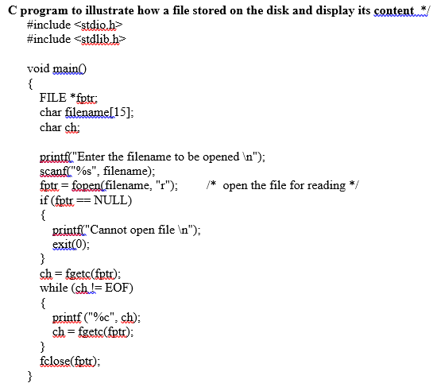
Files

Slide 21
4.5 Error Handling in C
C language does not provide any direct support for error handling.
However a few methods and variables defined in error.h header file can be used to point out error using the return statement in a function.
In C language, a function returns -1 or NULL value in case of any error and a global variable errno is set with the error code.

Slide 22
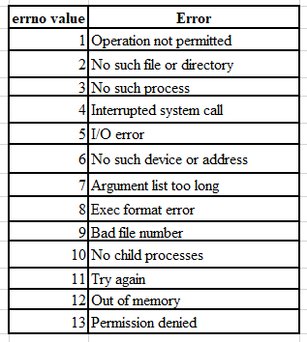
4.5 Error Handling in C
errno
It is a global variable, which can be used to identify which type of error was encountered while function execution, based on its value.

Slide 23
4.5 Error Handling in C
Other ways of Error Handling
perror() and strerror() functions
We can also use Exit Status constants in the exit() function

Slide 24
4.6 Files
Formatted Input & Output, Character Input and Output Functions

Slide 25
Structure
C typedef
The typedef is a keyword that is used to provide existing data types with a new name.
The C typedef keyword is used to redefine the name of already existing data types.
When names of datatypes become difficult to use in programs, typedef is used with user-defined datatypes, which behave similarly to defining an alias for commands.
typedef existing_name alias_name;
typedef long long ll;

Slide 26
Structure
C typedef
// C program to implement typedef
#include <stdio.h>
// defining an alias using typedef
typedef long int li;
int main()
{
// using typedef name to declare variable
li a = 20;
printf("%ld", a);
return 0;
}

Slide 27
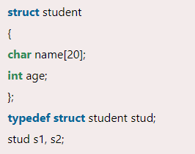
Structure
typedef struct
typedef can also be used with structures in the C programming language.
A new data type can be created and used to define the structure variable.

